Slide 1
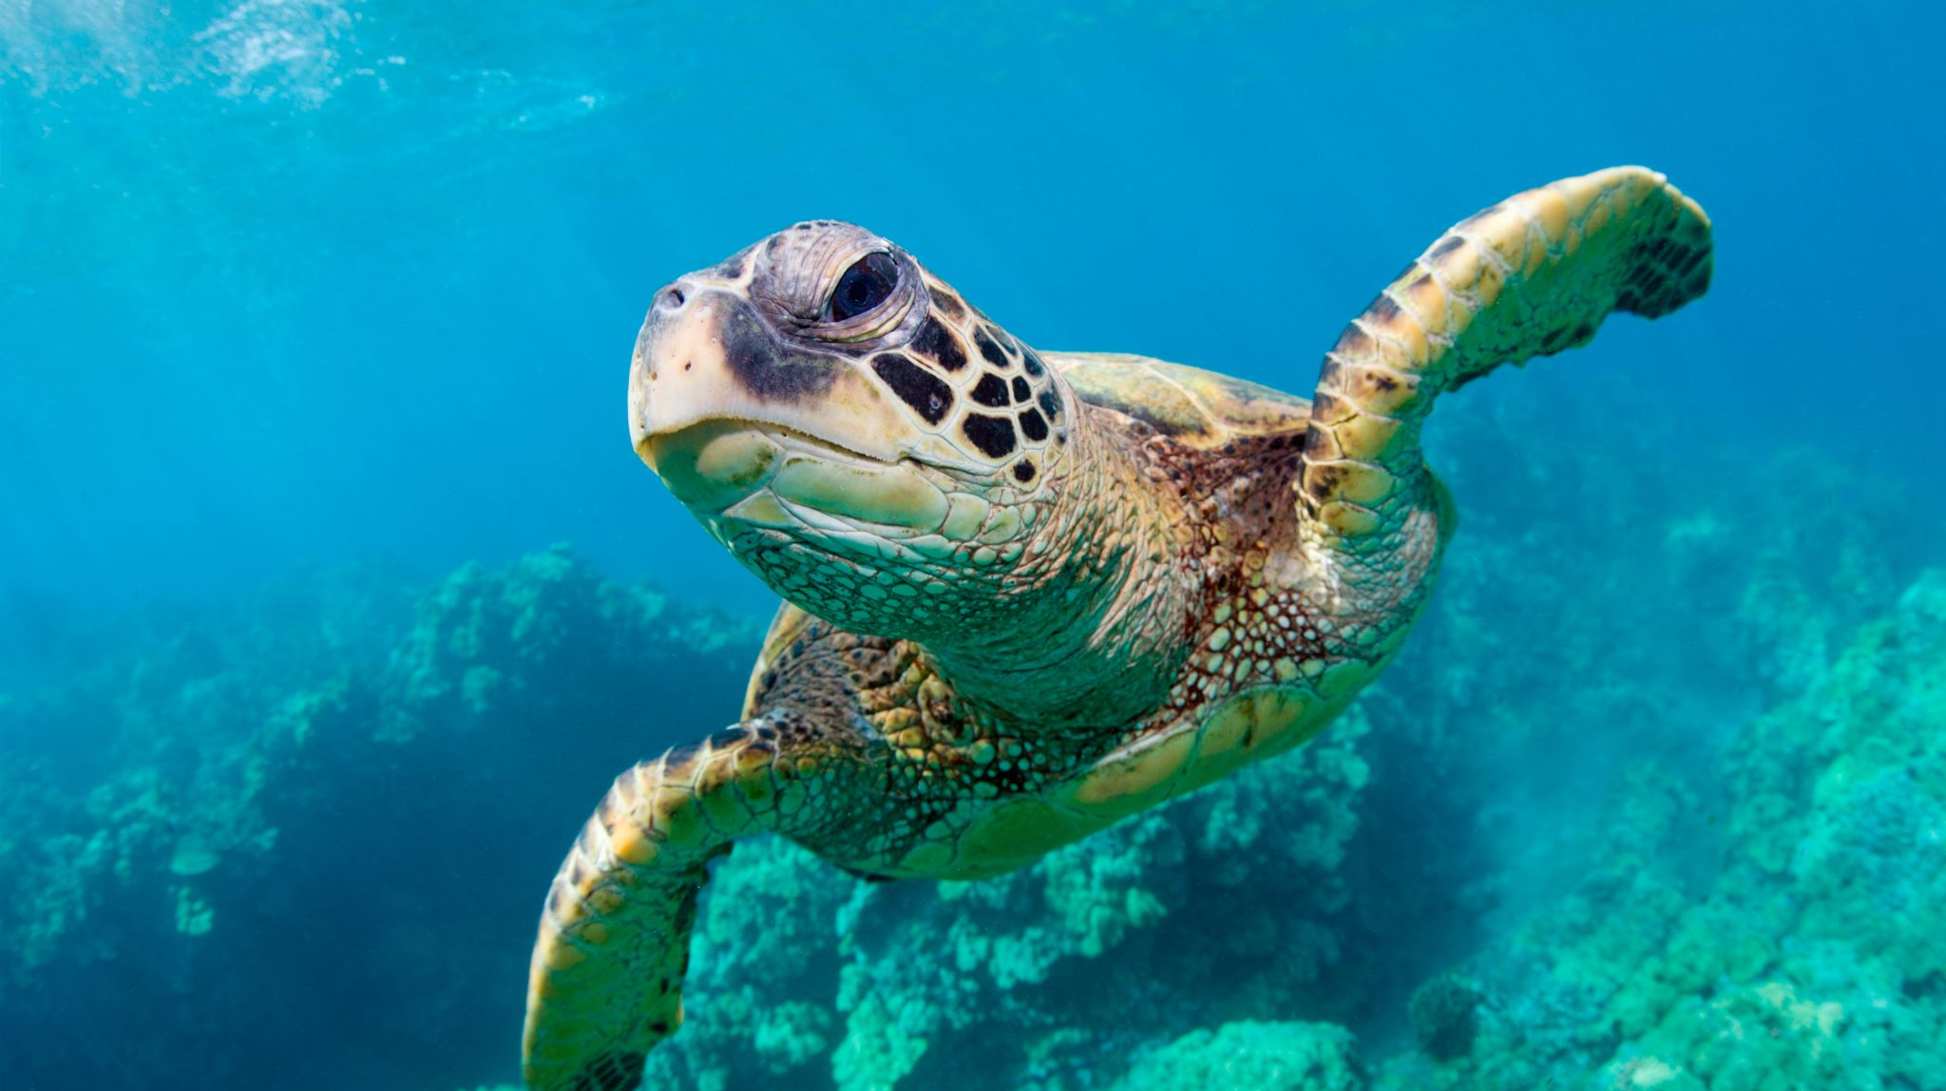
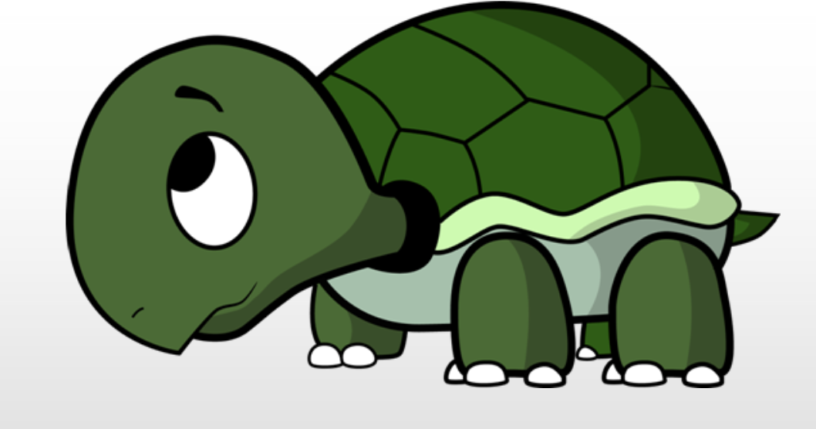
Turtle

Slide 2
Turtle? What is it? An animal?
Dr. Seymour Papert at MIT invented
a graphical and mathematical object
Inspired by the children’s programming language, Logo (1966)
Turtles➔drawing (many languages)
Turtle
understands the same actions(goto, forward, backward, etc.)
has the same fields but has its own values(heading, body and pen color, position, etc.)
Notes:
The Turtle, a computer-controlled robot which draws pictures, is used by Seymour Papert in teaching and exploring the processes of learning. Children become entranced with the problems of using logic to direct the Turtle's movements.
MIT in Perspective: A pictorial history of the Massachusetts Institute of Technology (Little, Brown and Company, 1975) by Francis E Wylie [p. 200]
Seymour Aubrey Papert (/ˈpæpərt/; 29 February 1928 – 31 July 2016) was a South African-born American mathematician, computer scientist, and educator, who spent most of his career teaching and researching at MIT.^{[2][3][4]} He was one of the pioneers of artificial intelligence, and of the constructionist movement in education.^{[5]} He was co-inventor, with Wally Feurzeig and Cynthia Solomon, of the Logo programming language.
Papert used Piaget's work in his development of the Logo programming language while at MIT. He created Logo as a tool to improve the way children think and solve problems. A small mobile robot called the "Logo Turtle" was developed, and children were shown how to use it to solve simple problems in an environment of play. A main purpose of the Logo Foundation research group is to strengthen the ability to learn knowledge.^{[17]} Papert insisted a simple language or program that children can learn—like Logo—can also have advanced functionality for expert users.^{[2]}
https://en.wikipedia.org/wiki/Seymour_Papert

Slide 3
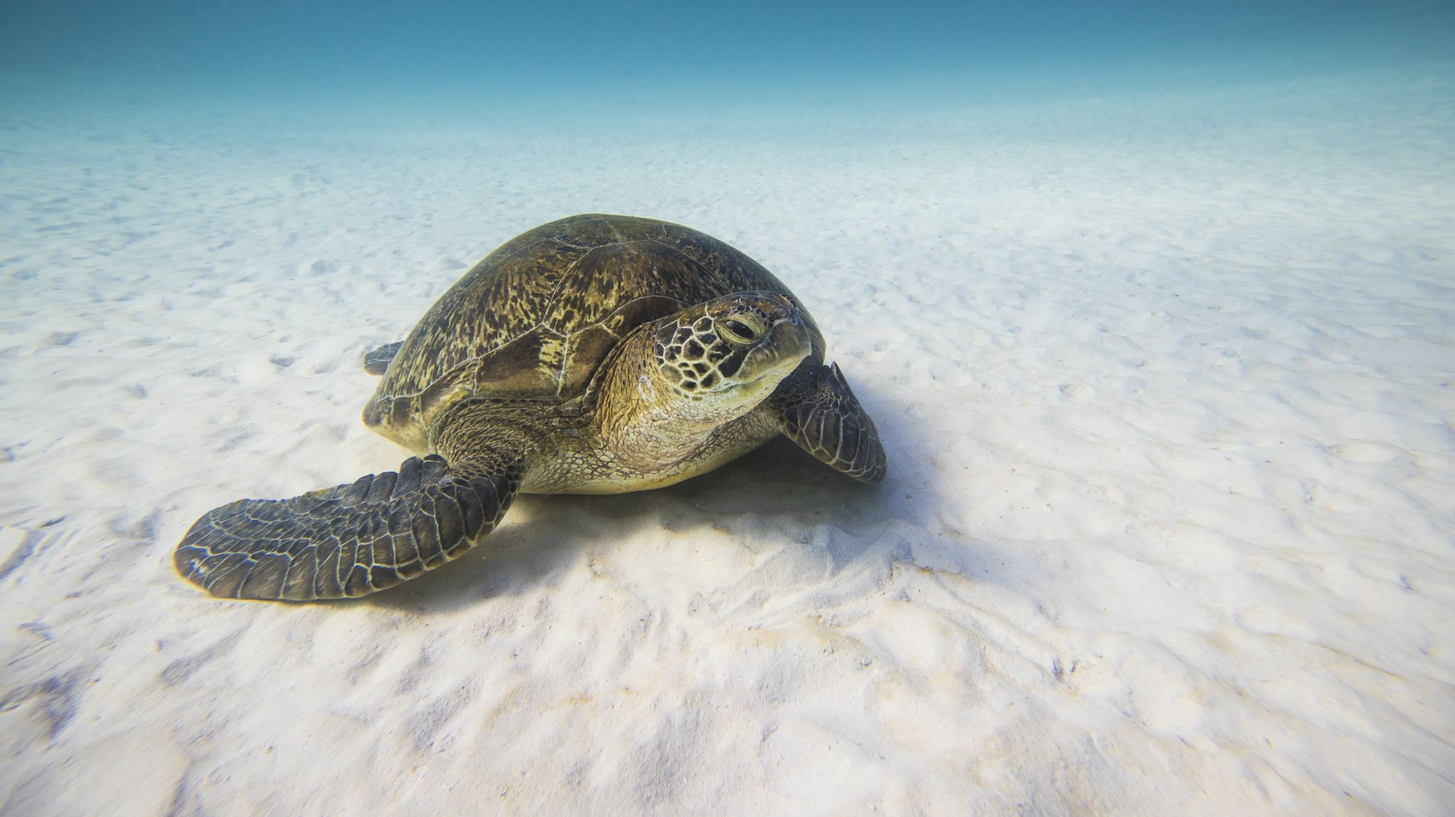
How it works? https://docs.python.org/3/library/turtle.html
Logic
Pen➔turtle
Paper➔window
Drawing➔turtle crawling
Position➔(x, y) coordinates
Cartesian coordinate system➔origin (0, 0) at the center of a window
Design
import the turtle module ➔ import turtle
create a window ➔ turtle.Screen()
create turtle object ➔turtle.Turtle()
use turtle methods ➔ see next page

Slide 4
Simple instructions
METHOD | PARAMETER | DESCRIPTION
Turtle() | None | It creates and returns a new turtle object
forward() | amount | It moves the turtle forward by the specified amount
backward() | amount | It moves the turtle backward by the specified amount
right() | angle | It turns the turtle clockwise
left() | angle | It turns the turtle counter clockwise
penup() , up() | None | It picks up the turtle’s Pen
pendown(), down() | None | Puts down the turtle’s Pen
color() | Color name | Changes the color of the turtle’s pen
fillcolor() | Color name | Changes the color of the turtle will use to fill a polygon
heading() | None | It returns the current heading
position() | None | It returns the current position
goto() | x, y | It moves the turtle to position x,y
begin_fill() | None | Remember the starting point for a filled polygon
end_fill() | None | It closes the polygon and fills with the current fill color

Slide 5
Simple instructions
METHOD | PARAMETER | DESCRIPTION
speed() | integer | It sets the animation speed of the turtle. 1 = slowest, 10 = fastest. 0 turns off animation completely
home() | None | It goes home (0, 0) and faces north
setheading() | angle | It points in direction angle degrees. 0 is east, 90 is north, 180 is west, 270 is south in standard mode
pos() | None | It returns the turtle position as x and y
circle() | radius | It draws a circle with the given radius (a number). radius can be negative.
circle() | Radius, angle | It draws a part of a circle with the given radius (a number). radius can be negative. The angle denotes how much of the circle is drawn. For example, if angle is 180 then a semicircle will be drawn. angle can be negative.
pensize() | integer | It sets the size of the pen to the given integer.
pencolor() | Color name | It sets the color of the pen to the given color name.
clearstamps() | None | It clears all the stamps on the screen
clearstamp() | integer | It clears the stamp with the given integer stamp id
dot() | None | Leaves the dot at the current position
stamp() | None | Leaves an impression of a turtle shape at the current location
shape() | shapename | Should be ‘arrow’, ‘classic’, ‘turtle’ or ‘circle’

Slide 6
Turtle is waiting for your commands
Where is it?
Starts at (0, 0)➔center
What to do?
Tell it to go forward➔ turtle.forward(distance)
it moves (on-screen) distance pixels
in the direction it is facing,
drawing a line as it moves.
Change its direction➔ turtle.left(angle)
it rotates in-place angle degrees counter-clockwise.
Change its direction➔ turtle.right(angle)
it rotates in-place angle degrees clockwise.

Slide 7
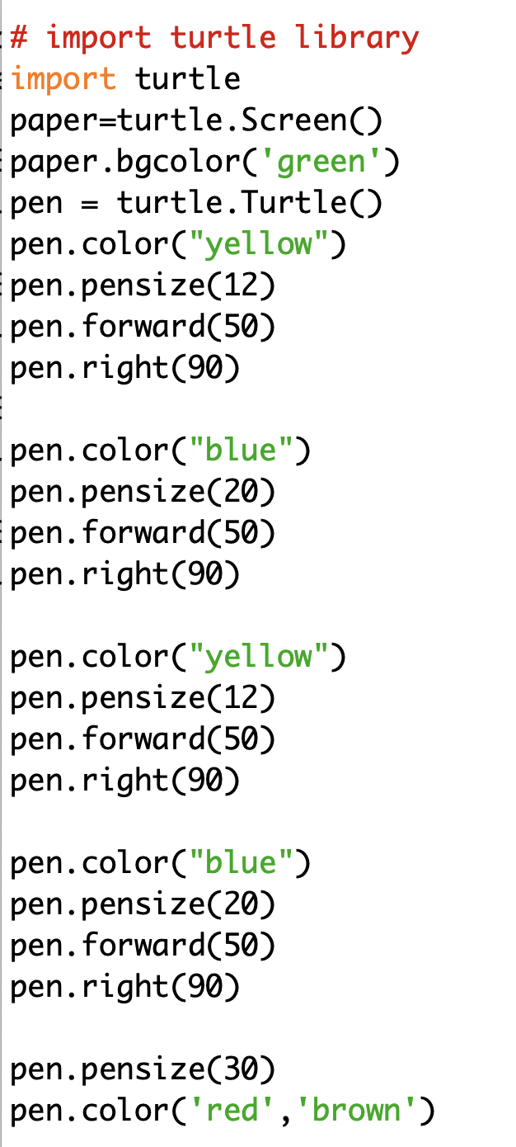
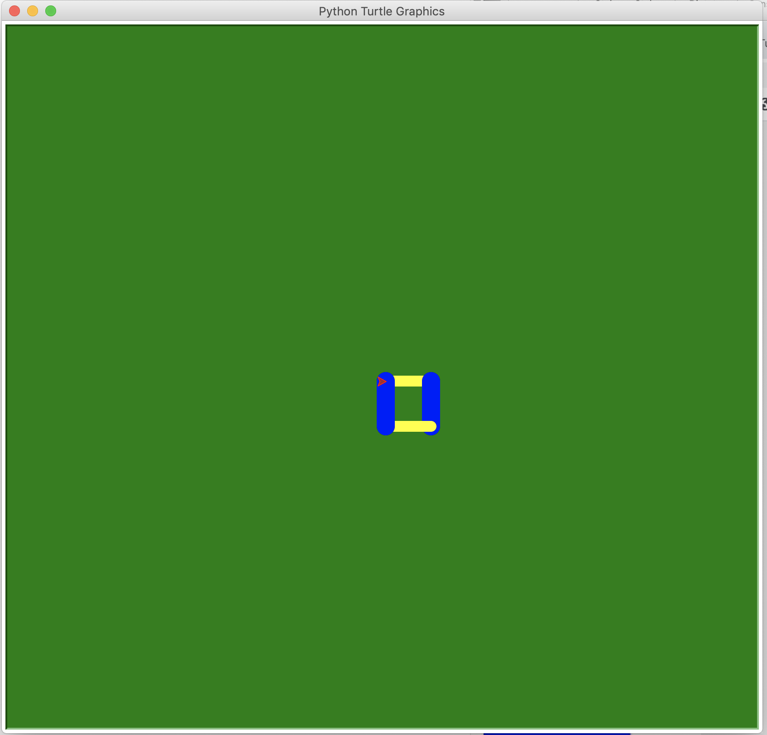
Code
Output
Notes:
# import turtle library
import turtle
paper=turtle.Screen()
paper.bgcolor('green')
pen = turtle.Turtle()
pen.color("yellow")
pen.pensize(12)
pen.forward(50)
pen.right(90)
pen.color("blue")
pen.pensize(20)
pen.forward(50)
pen.right(90)
pen.color("yellow")
pen.pensize(12)
pen.forward(50)
pen.right(90)
pen.color("blue")
pen.pensize(20)
pen.forward(50)
pen.right(90)
pen.pensize(30)
pen.color('red','brown')

Slide 8
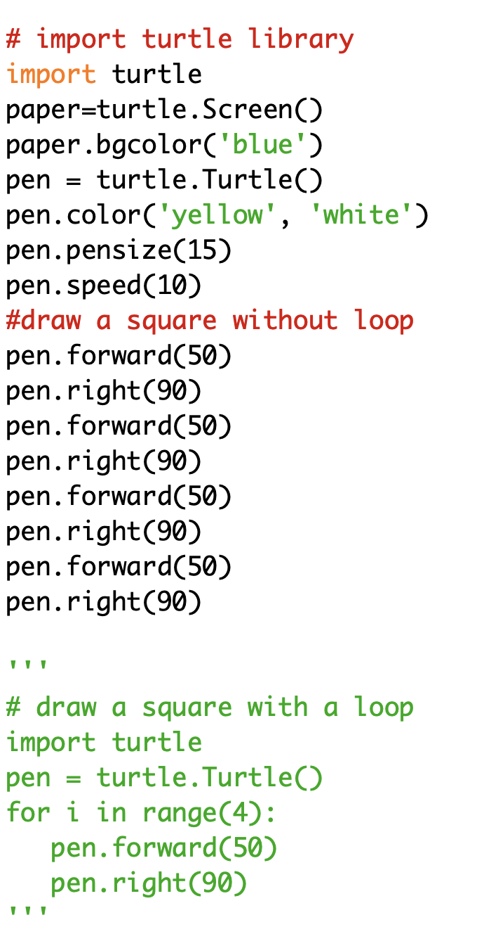
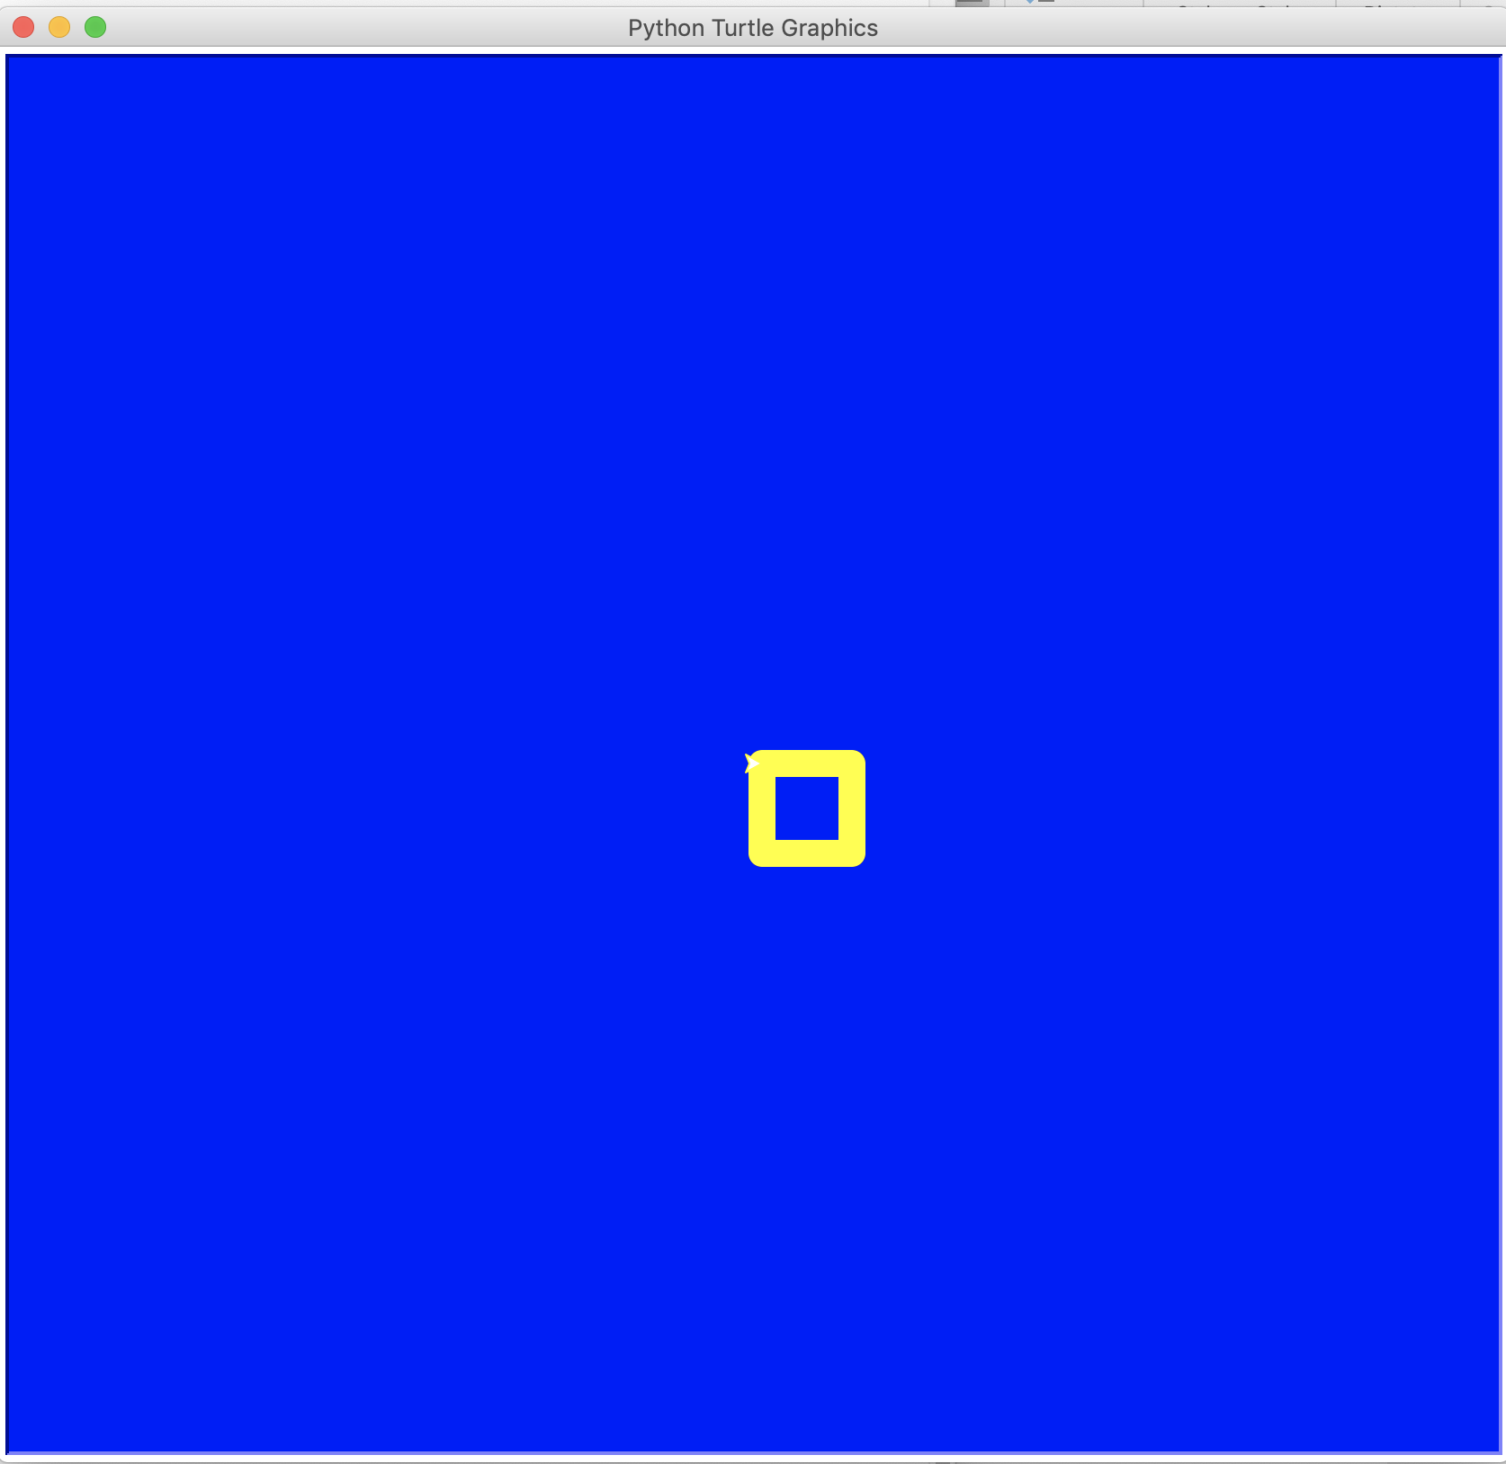
Code
Output
Notes:
# import turtle library
import turtle
paper=turtle.Screen()
paper.bgcolor('blue')
pen = turtle.Turtle()
pen.color('yellow', 'white')
pen.pensize(15)
pen.speed(10)
pen.forward(50)
pen.right(90)
pen.forward(50)
pen.right(90)
pen.forward(50)
pen.right(90)
pen.forward(50)
pen.right(90)
'''
# draw a square with a loop
import turtle
pen = turtle.Turtle()
for i in range(4):
pen.forward(50)
pen.right(90)
'''

Slide 9
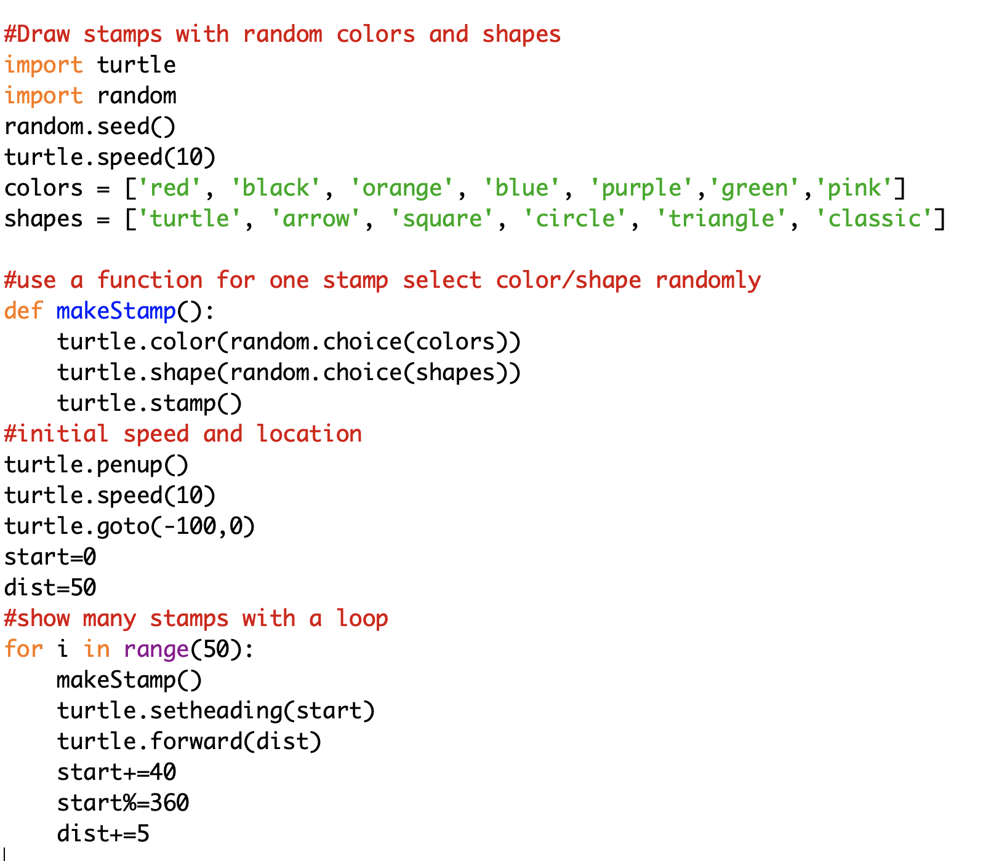
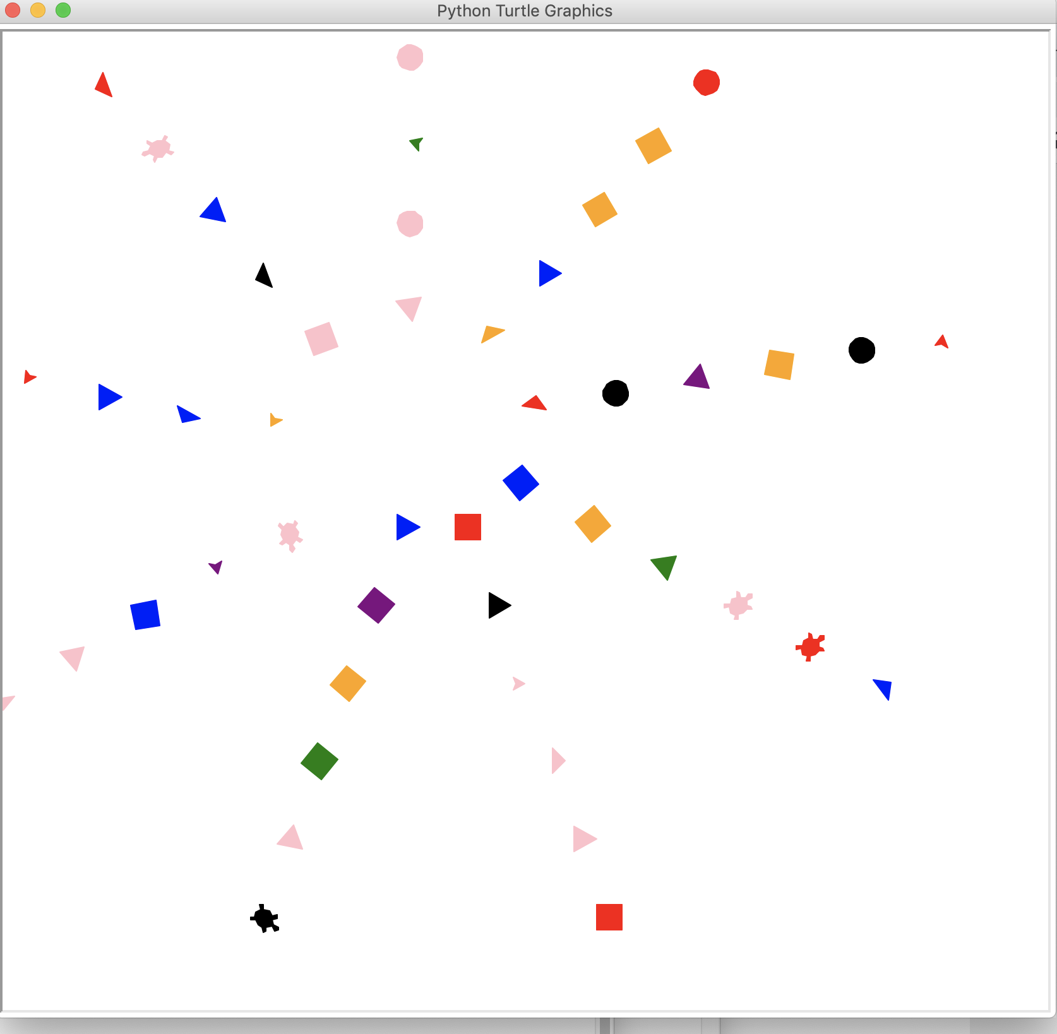
Code
Output
Notes:
#Draw stamps with random colors and shapes
import turtle
import random
random.seed()
turtle.speed(10)
colors = ['red', 'black', 'orange', 'blue', 'purple','green','pink']
shapes = ['turtle', 'arrow', 'square', 'circle', 'triangle', 'classic']
#use a function for one stamp select color/shape randomly
def makeStamp():
turtle.color(random.choice(colors))
turtle.shape(random.choice(shapes))
turtle.stamp()
#initial speed and location
turtle.penup()
turtle.speed(10)
turtle.goto(-100,0)
start=0
dist=50
#show many stamps with a loop
for i in range(50):
makeStamp()
turtle.setheading(start)
turtle.forward(dist)
start+=40
start%=360
dist+=5

Slide 10
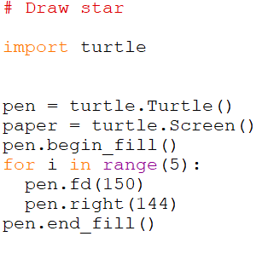
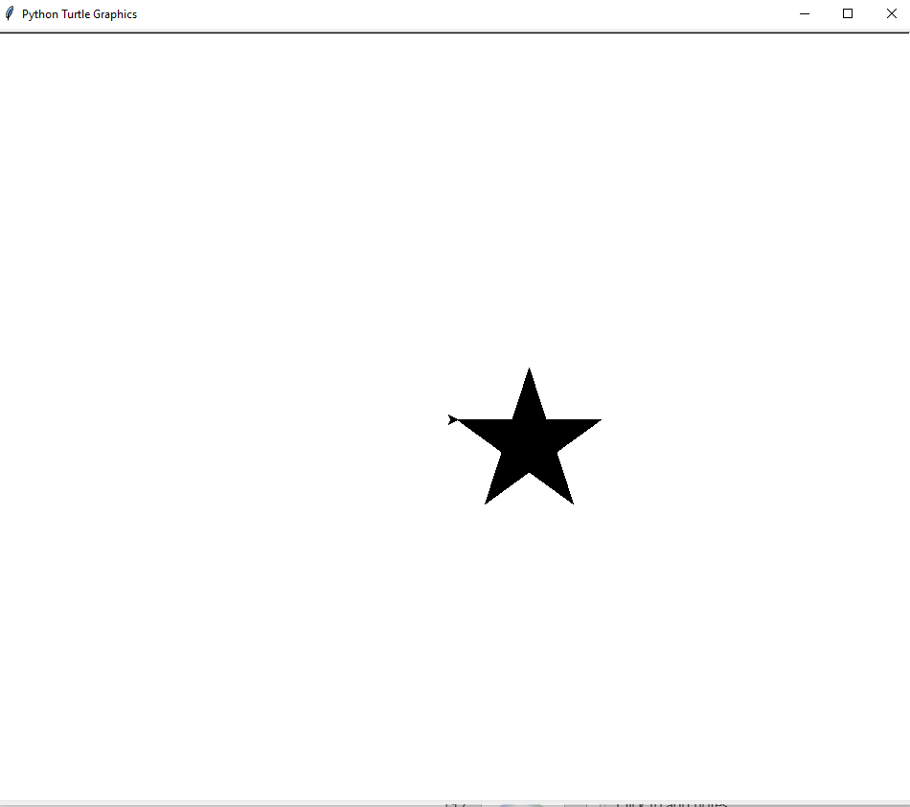
Notes:
# Draw star
import turtle
pen = turtle.Turtle()
paper = turtle.Screen()
pen.begin_fill()
for i in range(5):
pen.fd(150)
pen.right(144)
pen.end_fill()

Slide 11
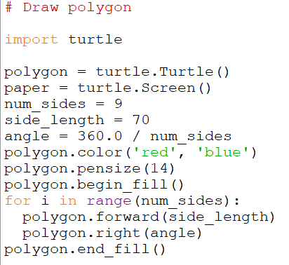
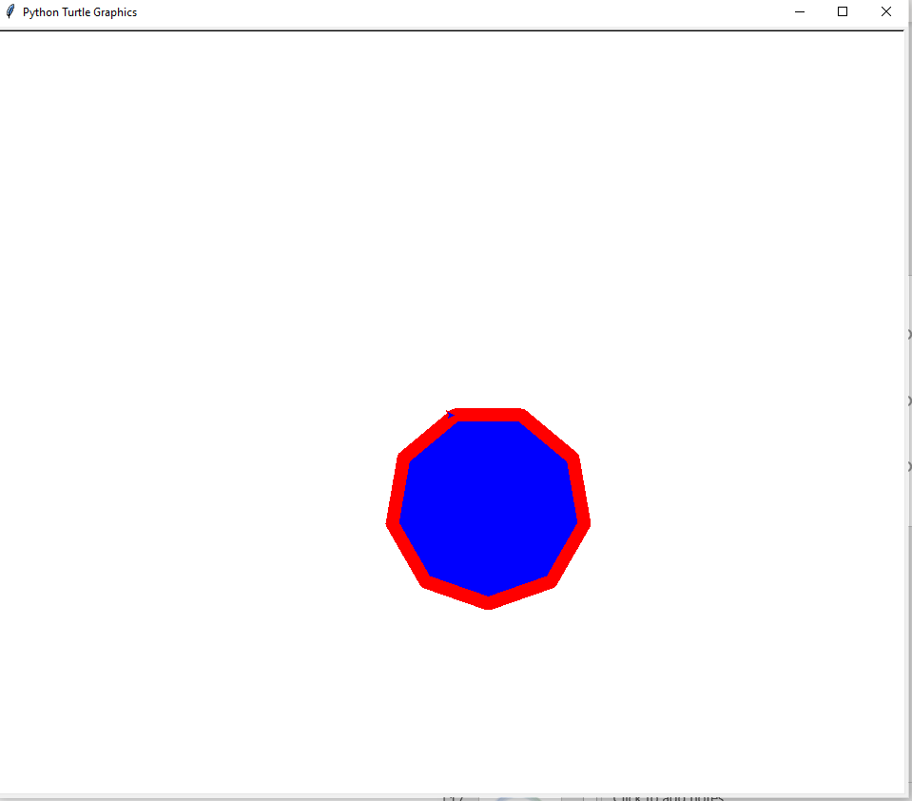
Notes:
# Draw polygon
import turtle
polygon = turtle.Turtle()
paper = turtle.Screen()
num_sides = 9
side_length = 70
angle = 360.0 / num_sides
polygon.color('red', 'blue')
polygon.pensize(14)
polygon.begin_fill()
for i in range(num_sides):
polygon.forward(side_length)
polygon.right(angle)
polygon.end_fill()

Slide 12
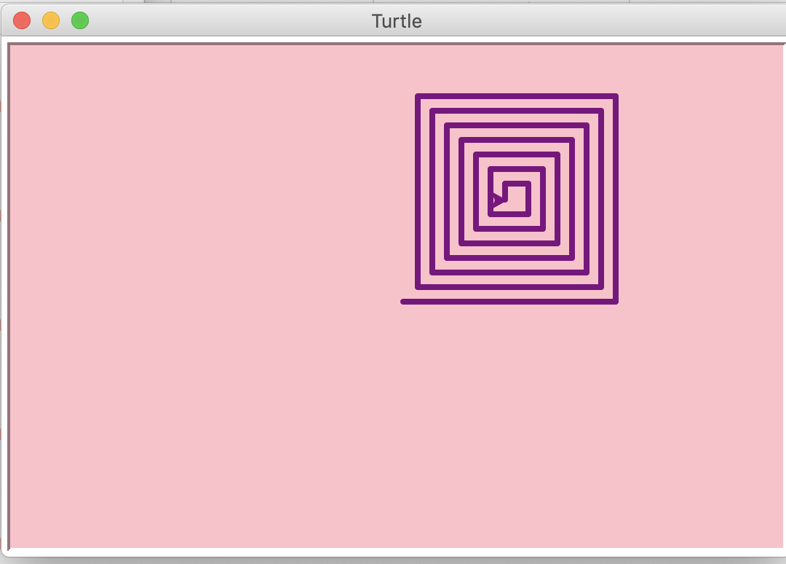


Slide 13
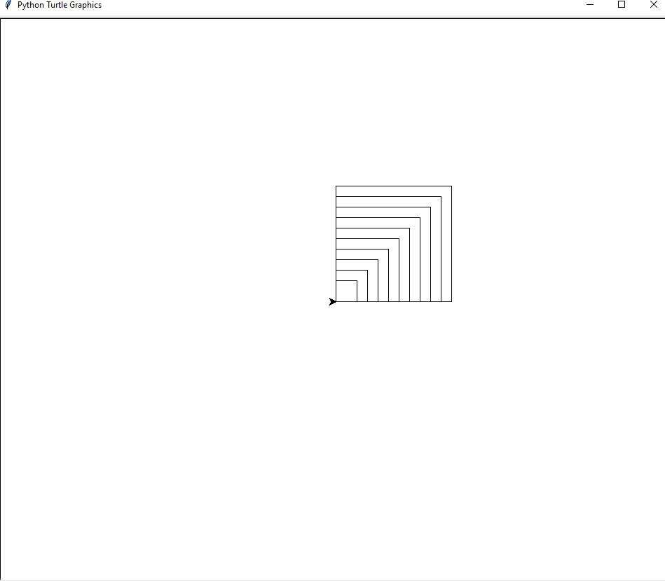


Slide 14
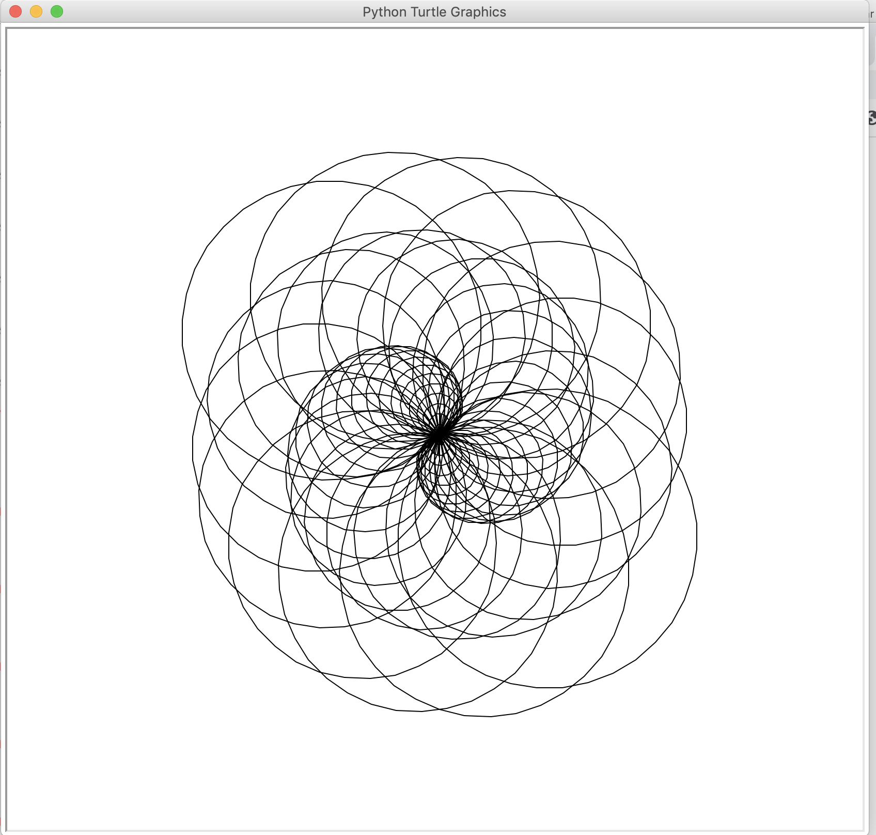

Slide 15
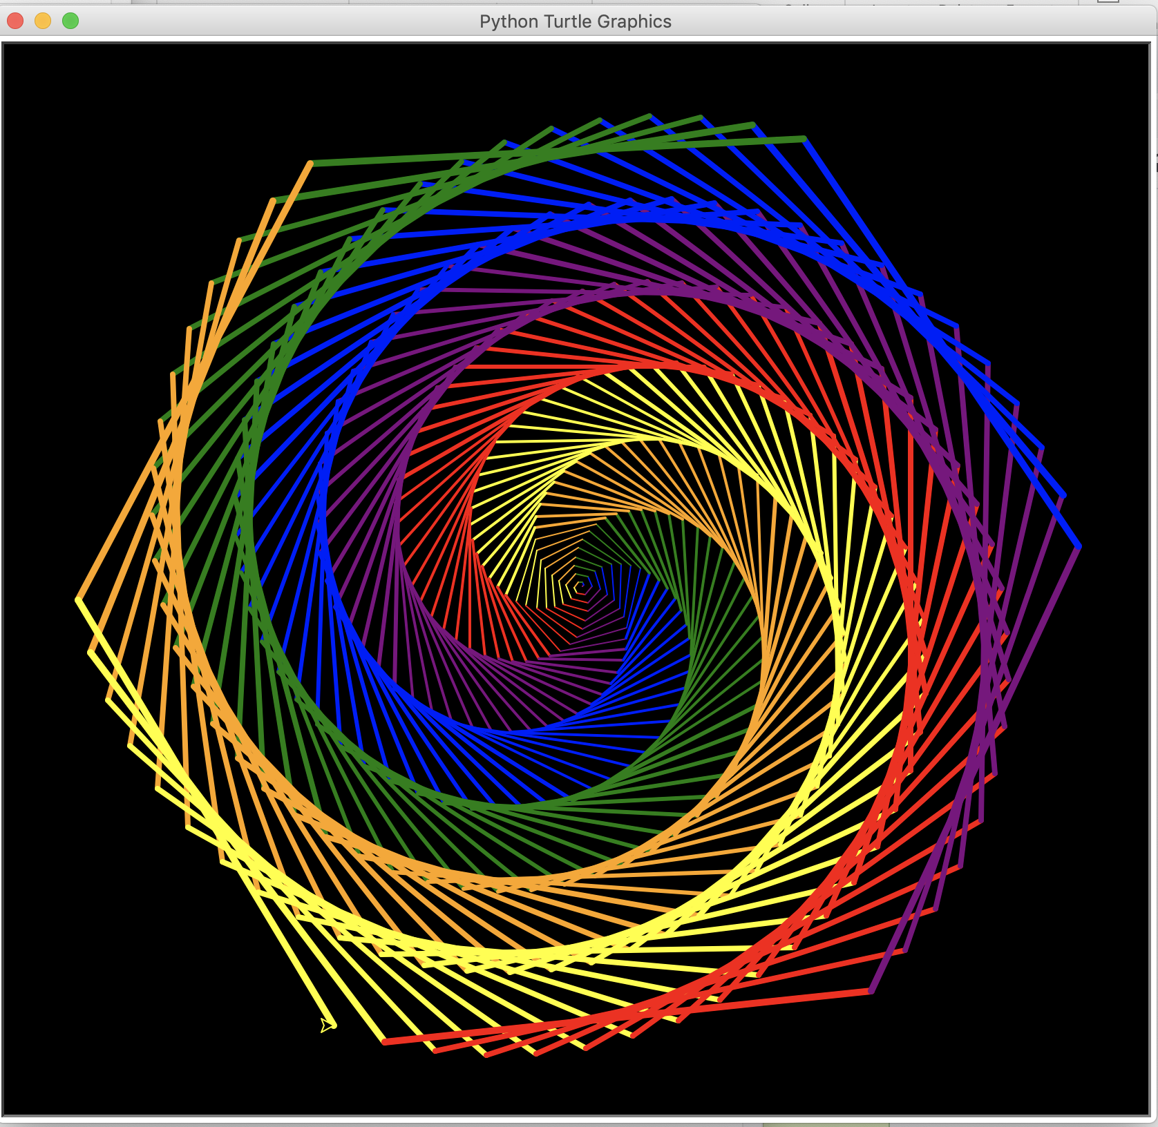


Slide 16


Let’s have some fun
Use turtle to draw a picture.
Try to include colors, shapes, speeds, stamps, etc.
Post your masterpiece to discussion forum
Find original drawing(s) that are publicly available, and share in the forum
You may also try a multi-turtle program if you are curious and have time

Slide 17
References
https://www.tutorialspoint.com/turtle-programming-in-python
https://www.teachwithict.com/turtle_tutorial.html

